Slide 1
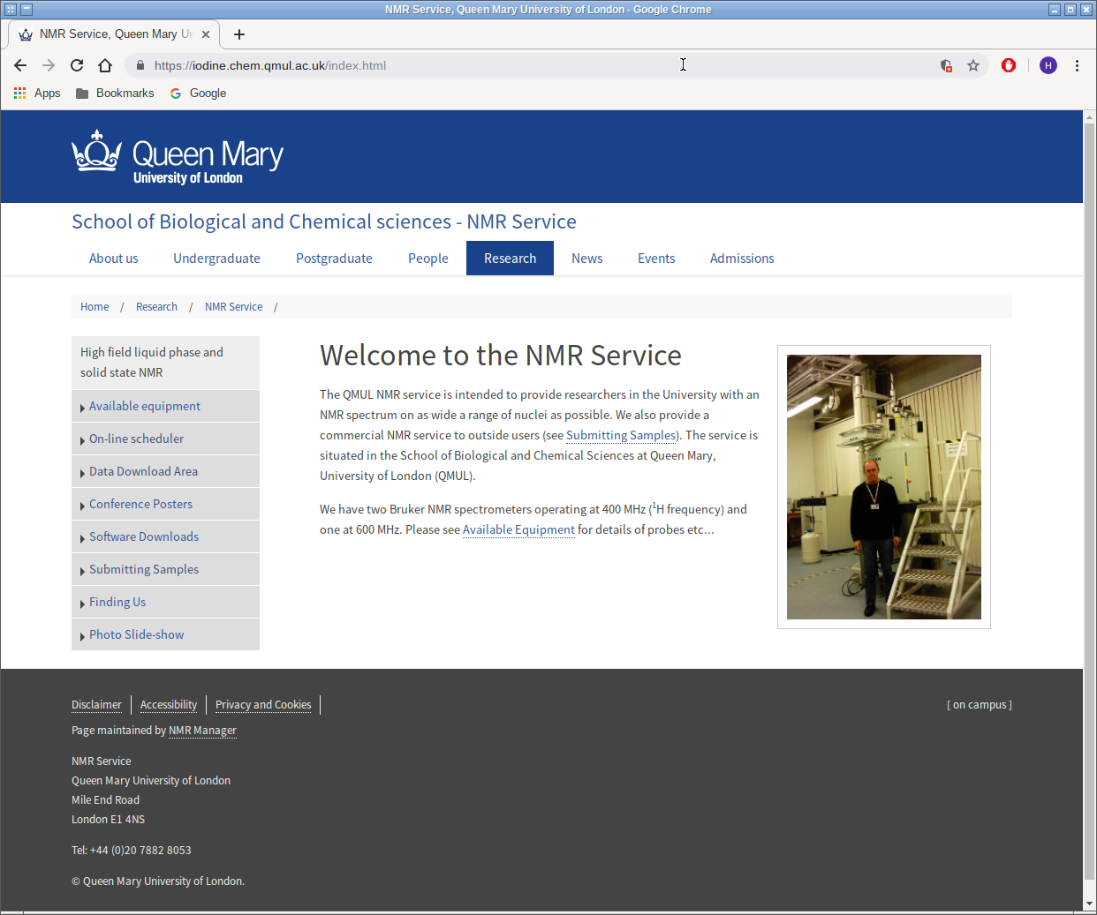

Slide 2
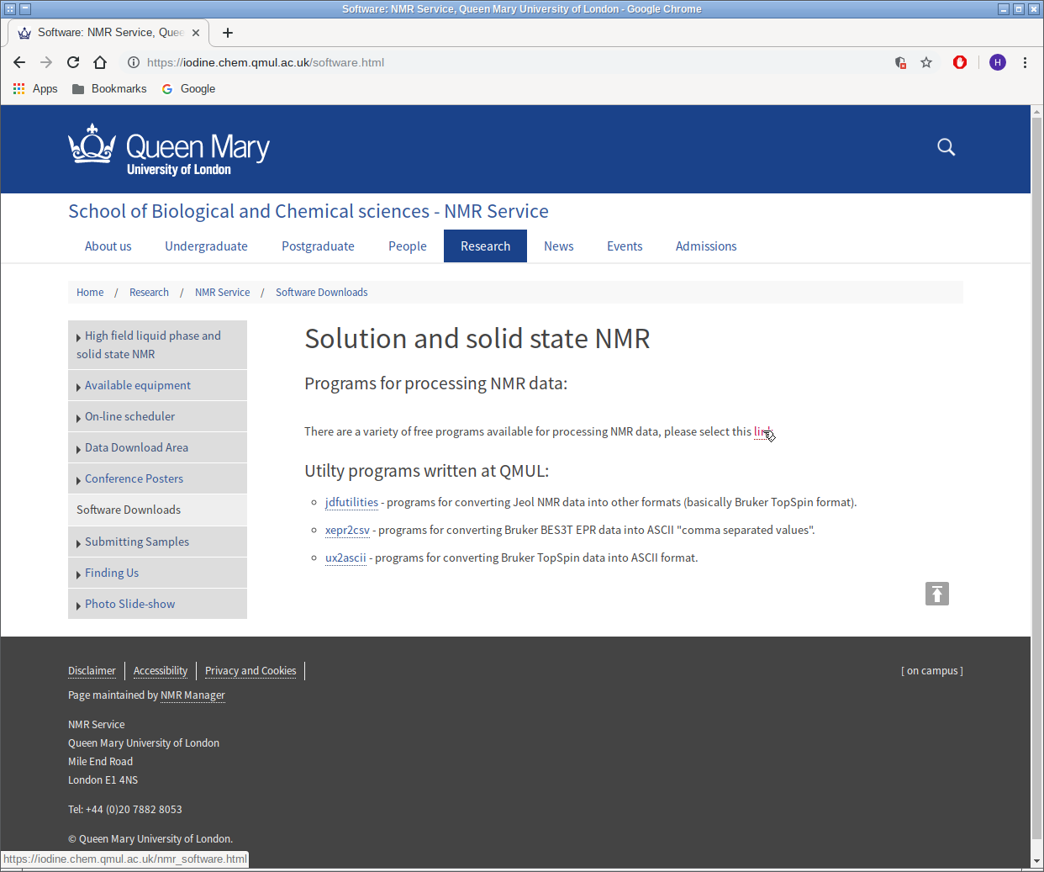

Slide 3
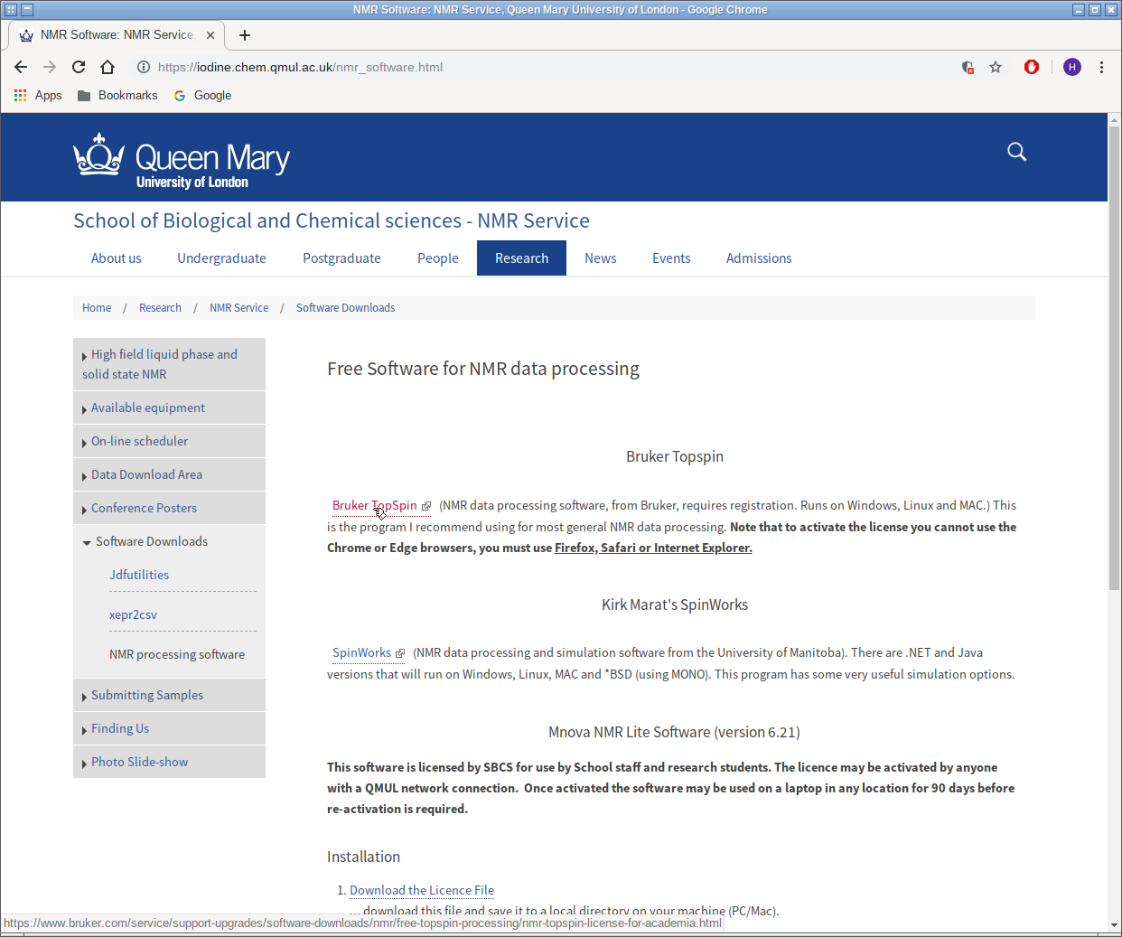

Slide 4
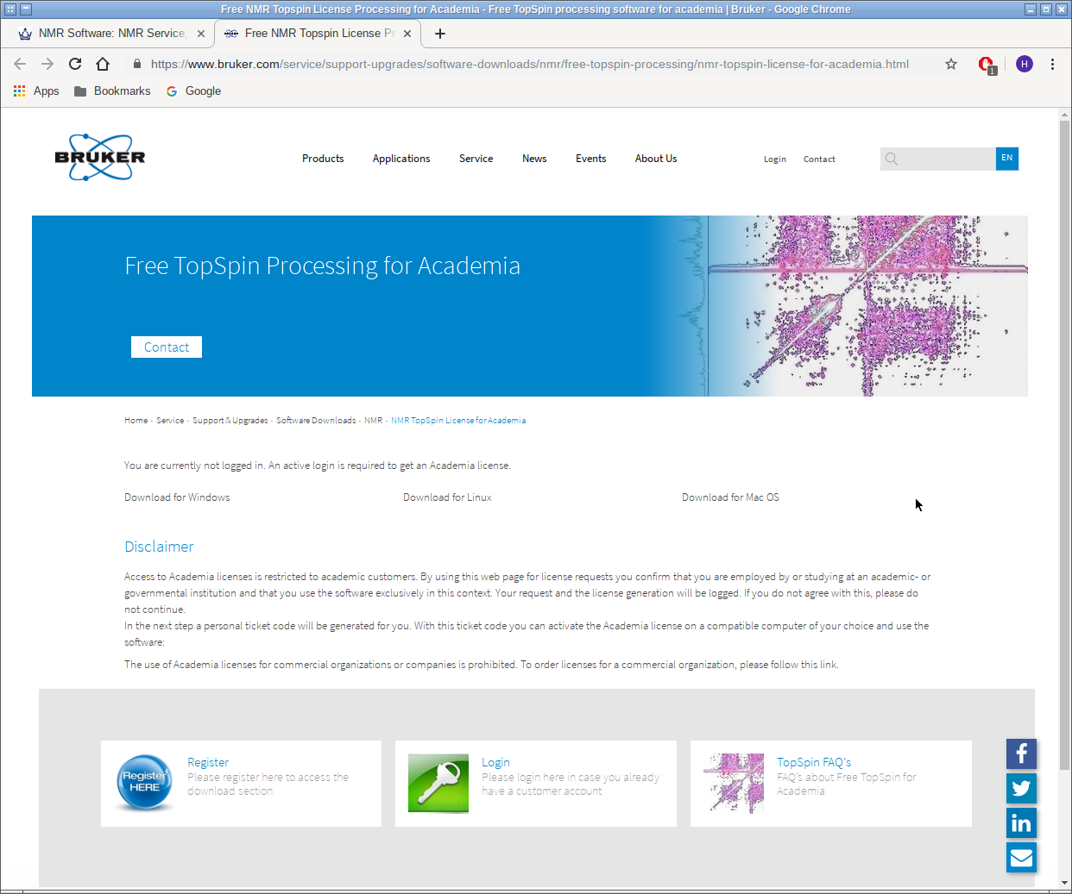

Slide 5
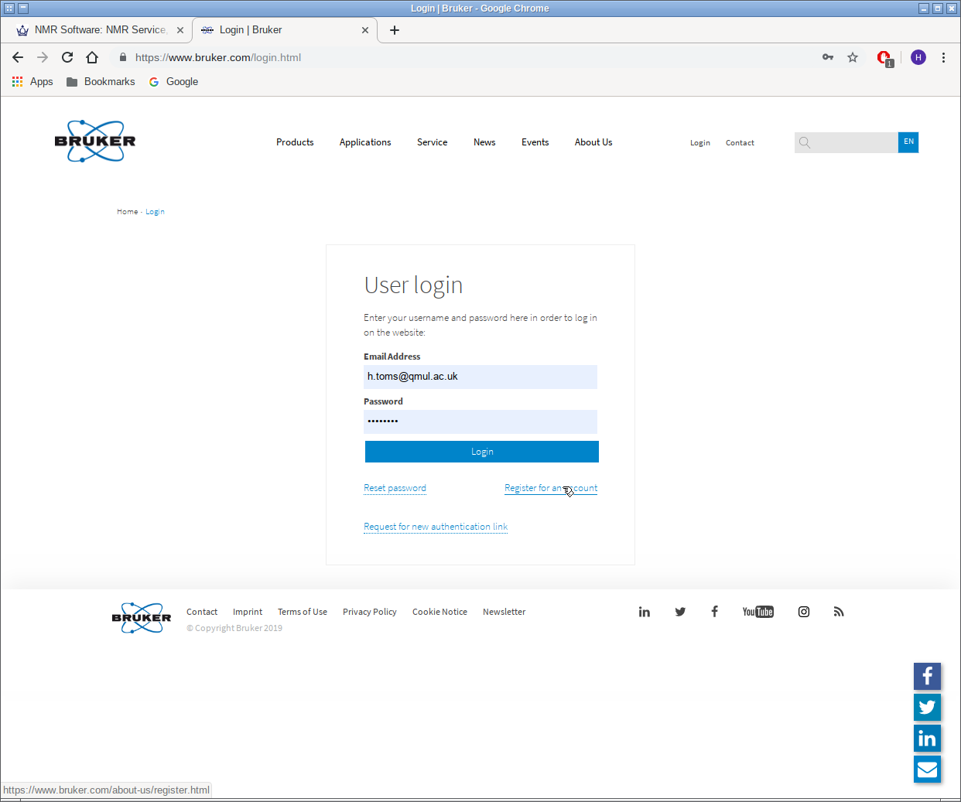

Slide 6
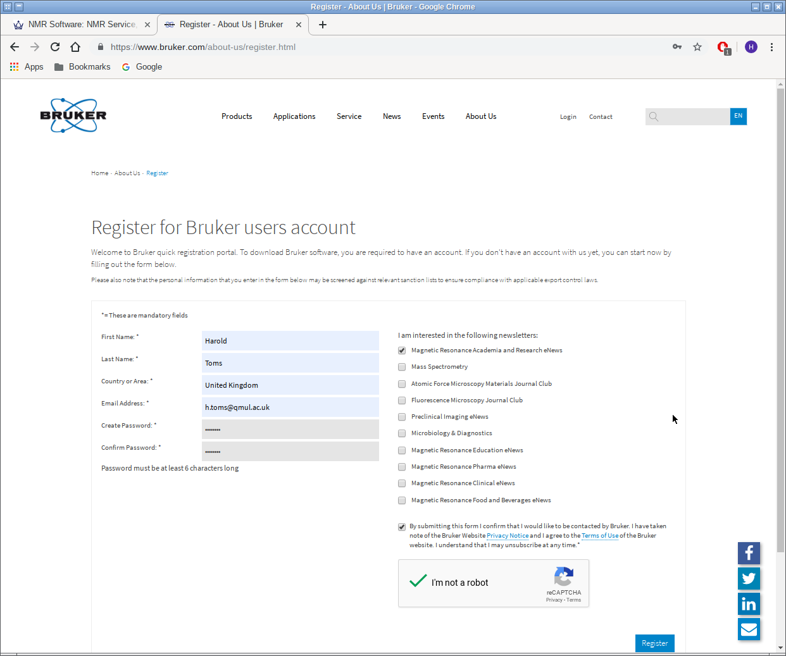

Slide 7
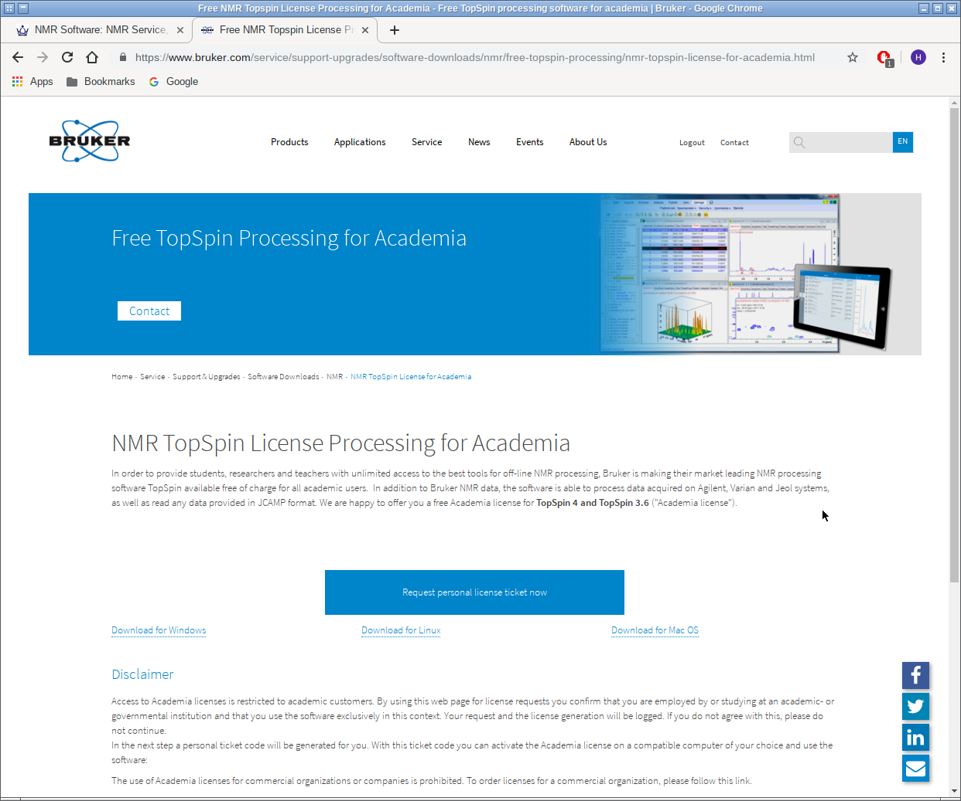

Slide 8
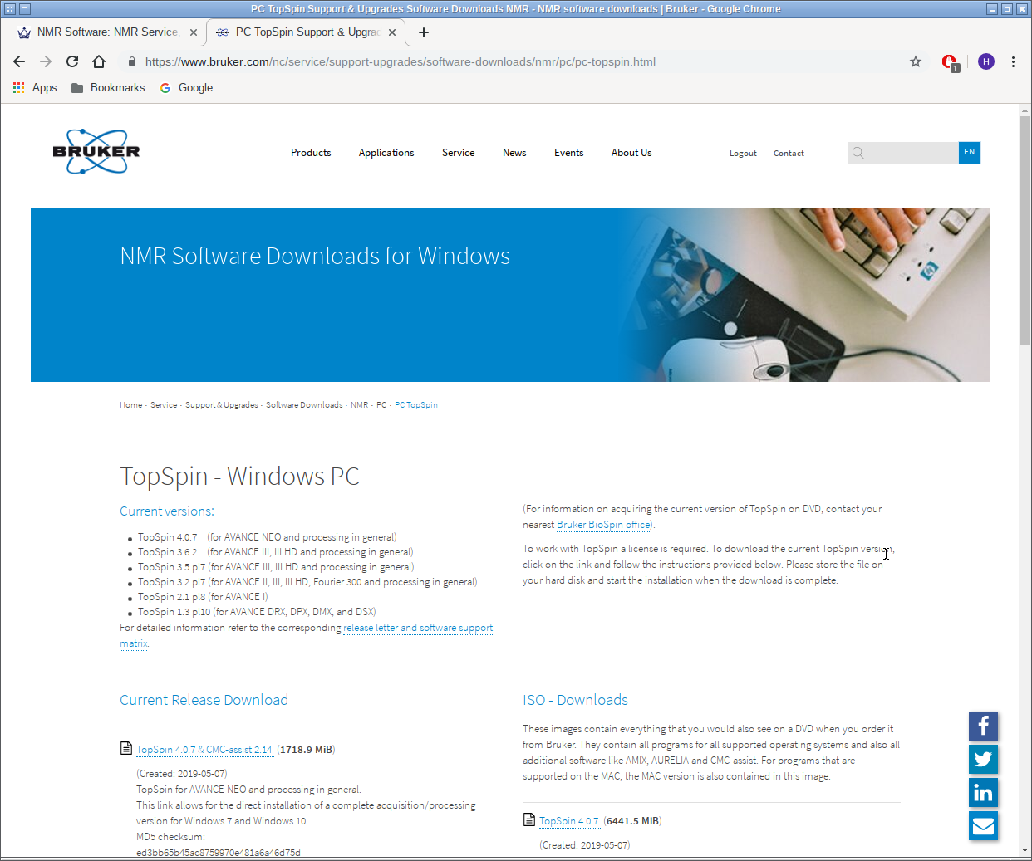

Slide 9
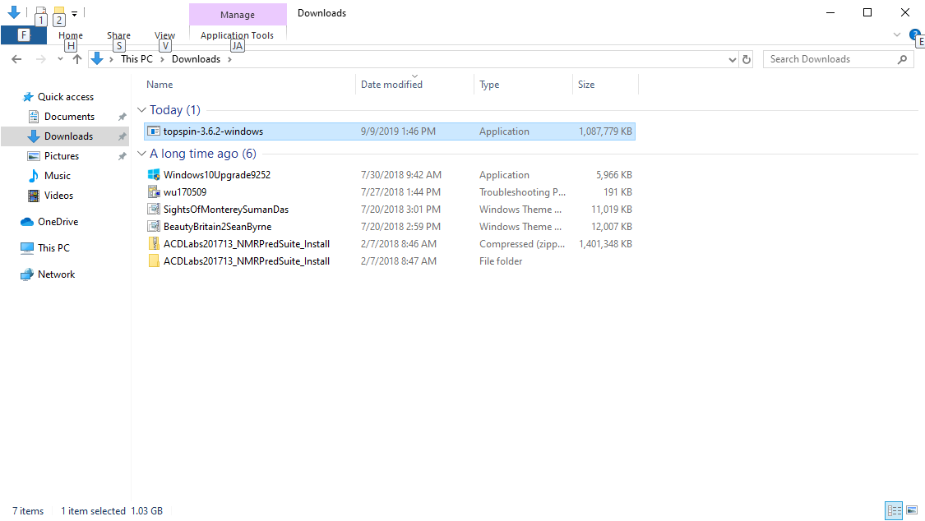
There are two versions of TopSpin supported (3 & 4). I recommend
version 3 which is a smaller download and matches the version on
the spectrometers and the lab. workstation and is used in the
handouts.

Slide 10
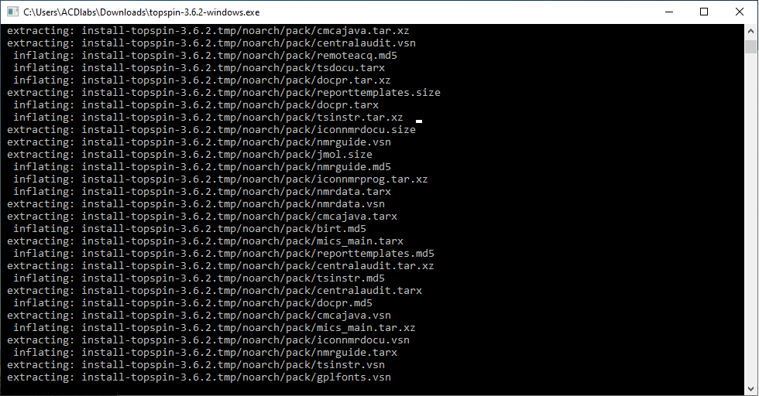
When you run the TopSpin installer, various temporary windows
will be opened, when the installation finishes they will all be
closed automatically.

Slide 11
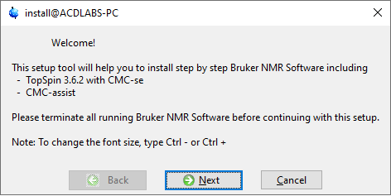
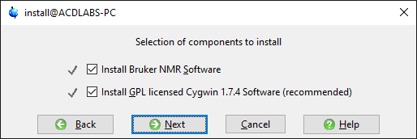
Once the installer has loaded, there will be a series of windows
which will require input of some type. The first window (above)
Just needs you to click on Next.
Do not change these options, again just choose Next.

Slide 12
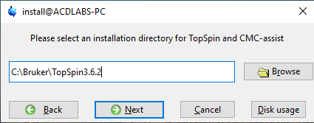
It is not necessary to read the TopSpin release letter, again just
choose Next.
The default installation directory is usually fine, so again just
choose Next.

Slide 13
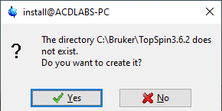
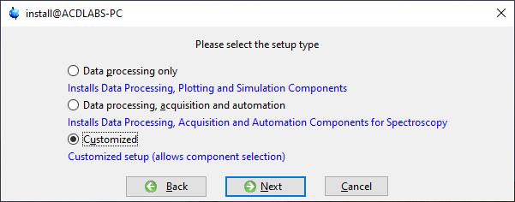
The installer will ask you to confirm the directory creation.
To avoid installing software you will not need, select Customized.

Slide 14
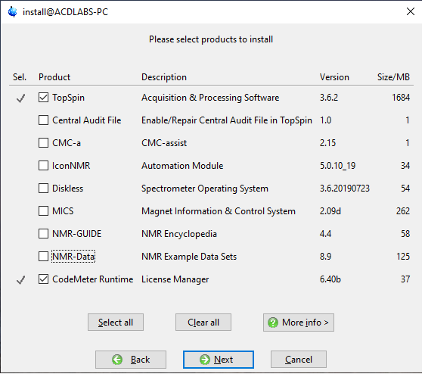
The only products you need are TopSpin and CodeMeter.

Slide 15
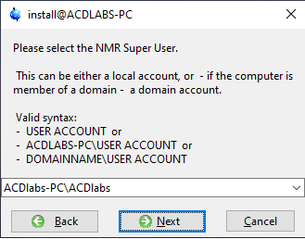
You will need to choose an account on your computer as the NMR
Super User (i.e. administrator). Usually you would select your own
login account.

Slide 16
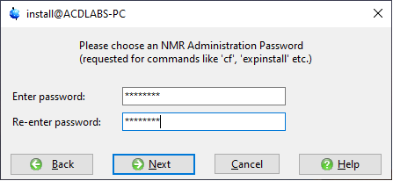
You will need to set a password for programme administration.
Note that this is asking for you to choose a password, not asking
for an existing password!

Slide 17
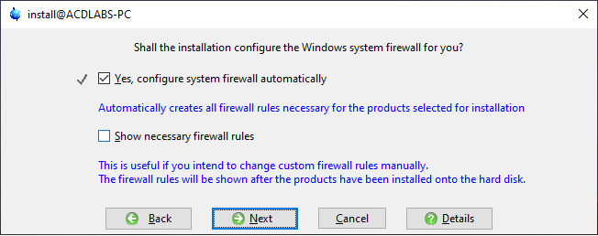
Let the installer configure the Windows firewall for you.

Slide 18
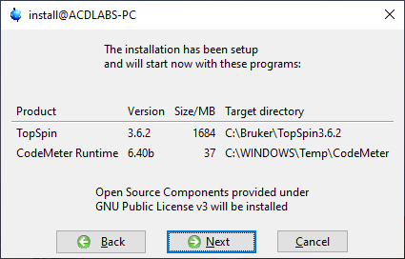
When you choose next, TopSpin will be installed.

Slide 19
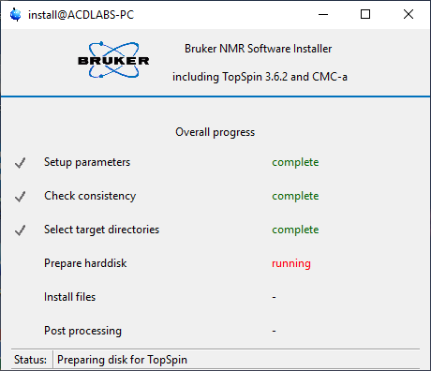
The installation will take
a long time, typically about
15 minutes. Various progress
bars will appear as the
components are un-packed
on to your computer.

Slide 20
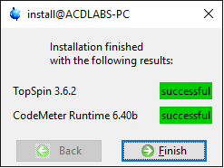
When finished, you should see the results. If anything fails you may
Have problems later when you try to use the program. An installation
logfile is created, so you can try and find out why something failed.
You should now find TopSpin as an option on the Start menu.

Slide 21
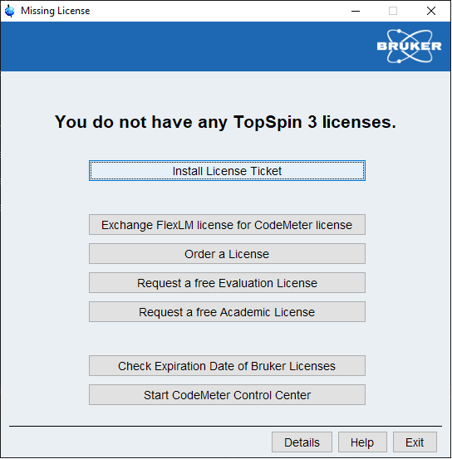
The first time you run
the program you will
get this window. Choose
the option to request a
free academic licence.
This should take you to
the Bruker website.

Slide 22
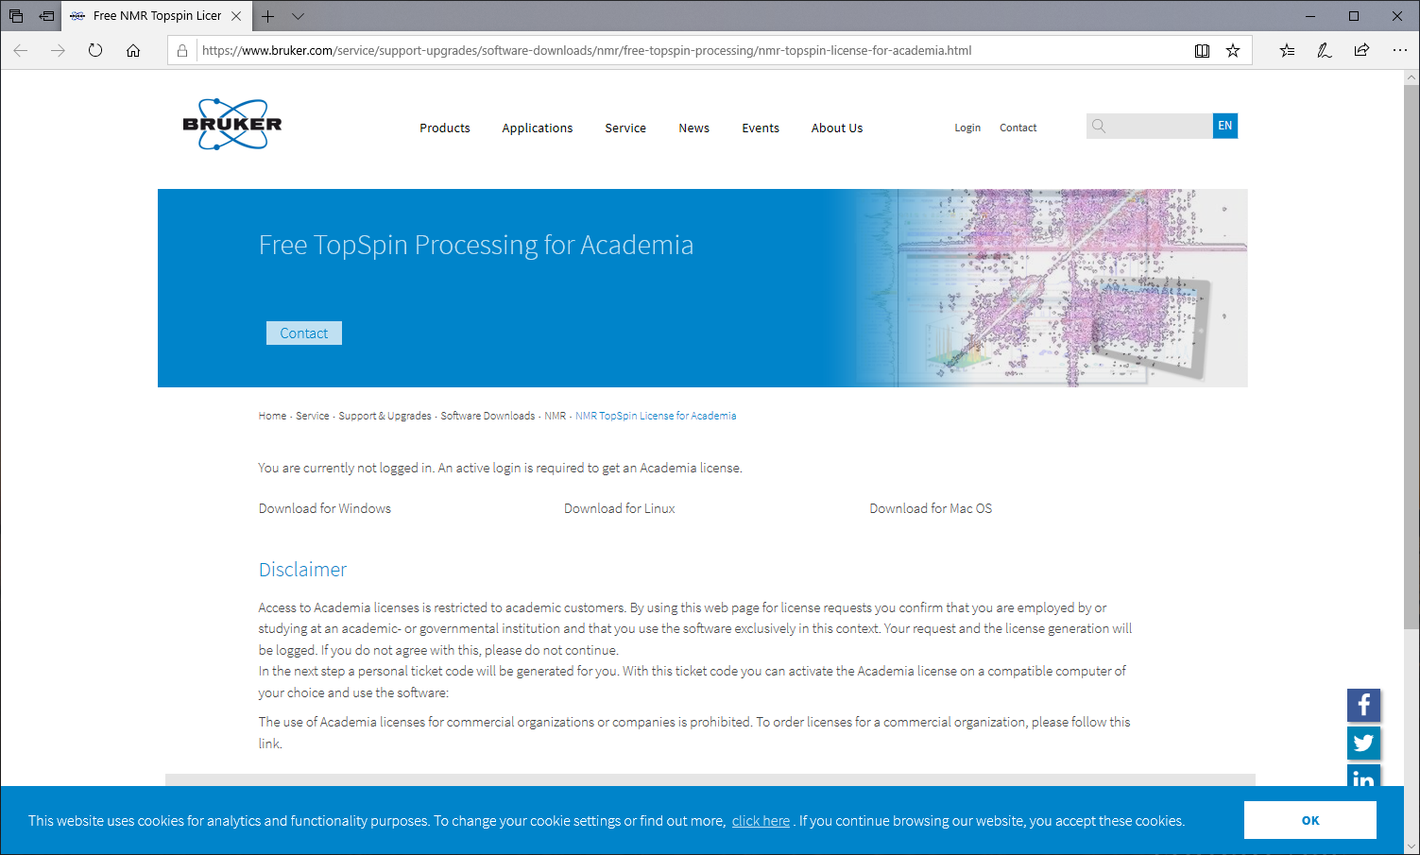
You will need to login before you can request a licence key.

Slide 23
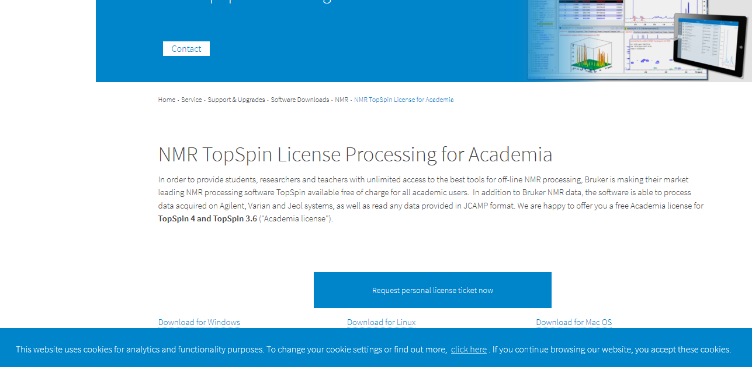
Once logged in the option to request a personal licence ticket
becomes available.

Slide 24
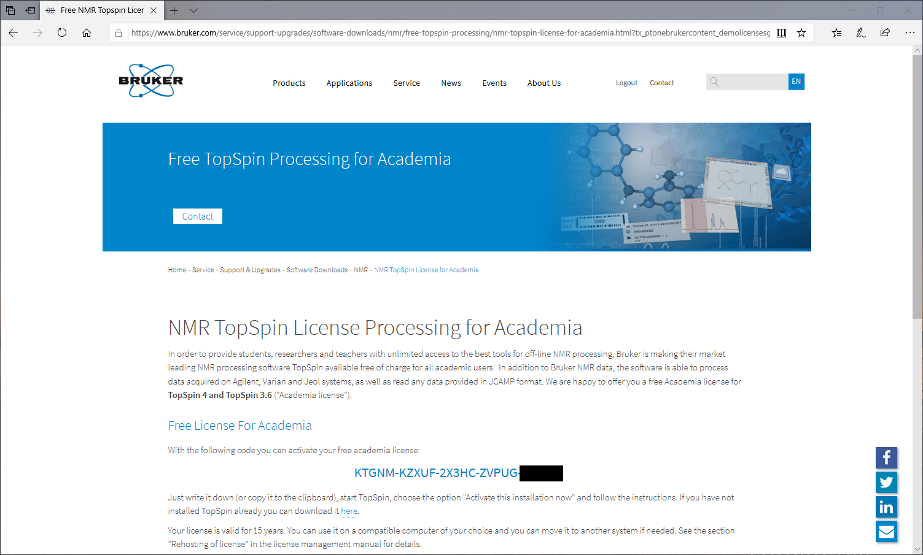
As the instructions say, you can either write down the activation
code, or copy it (CTRL-C) and then paste it into TopSpin (CTRL-V)
The option is “Install License Ticket” which will open a Browser window.
You must use either Internet Explorer or Firefox! Not Edge/Chrome.

Slide 25
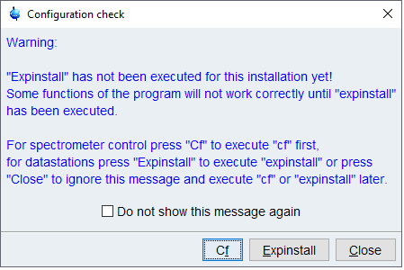
Topspin will now run, and the first thing it will do is request that you
configure the program. If you skip this step then lots of things wont
work… so don’t omit it. You do not need the “Cf” command (which
is for running spectrometers) you need the “Expinstall” option which
will configure your computer as a datastation.

Slide 26
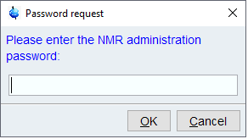
You will be asked for the administrator password that you set earlier.

Slide 27
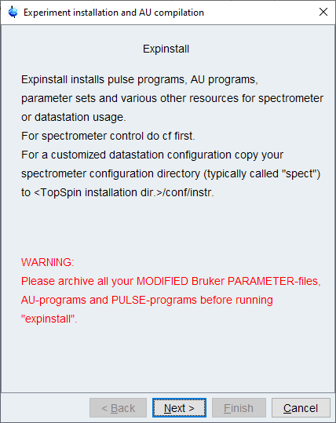
Choose Next.

Slide 28
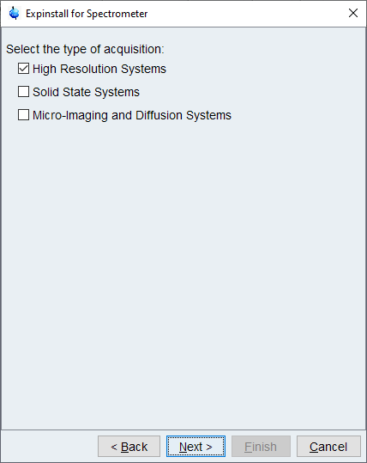
The default option (for high
resolution systems is fine.

Slide 29
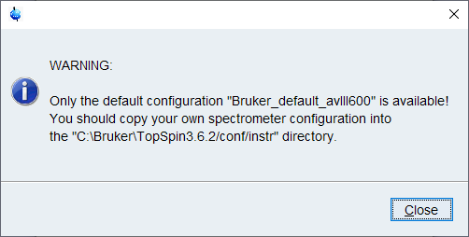
The default configuration “Bruker_default_avIII600” is also fine.

Slide 30
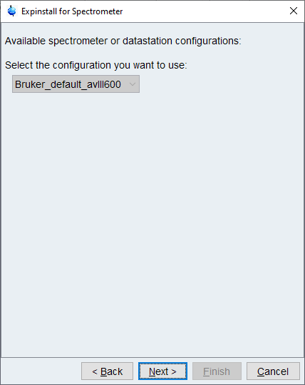
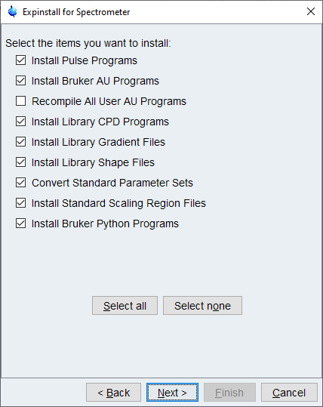
Choose next (with default options) for both these dialogue windows.

Slide 31
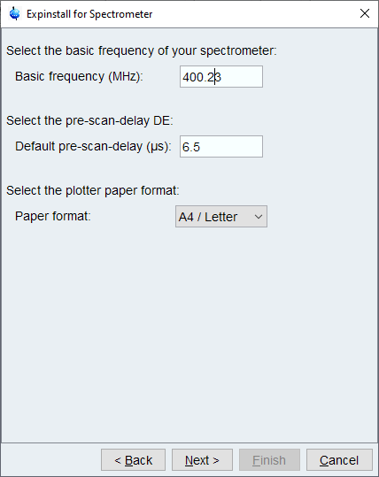
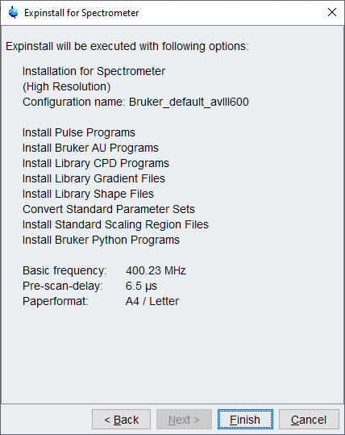
The Basic frequency for our 400 MHz spectrometers is 400.23.

Slide 32
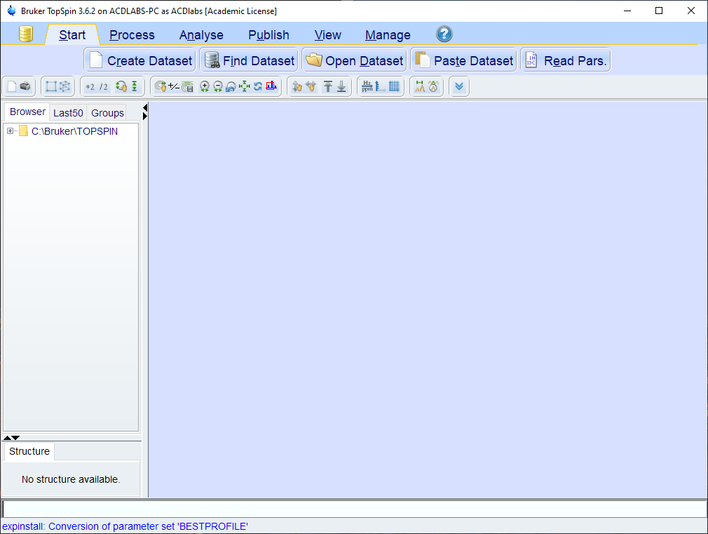
Do not quit the program until “Expinstall has finished (a few minutes).

Slide 33
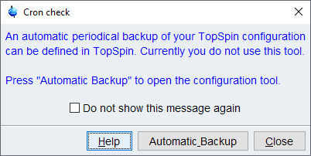
You will see this message when Expinstall finishes, choose “Close”.

Slide 34
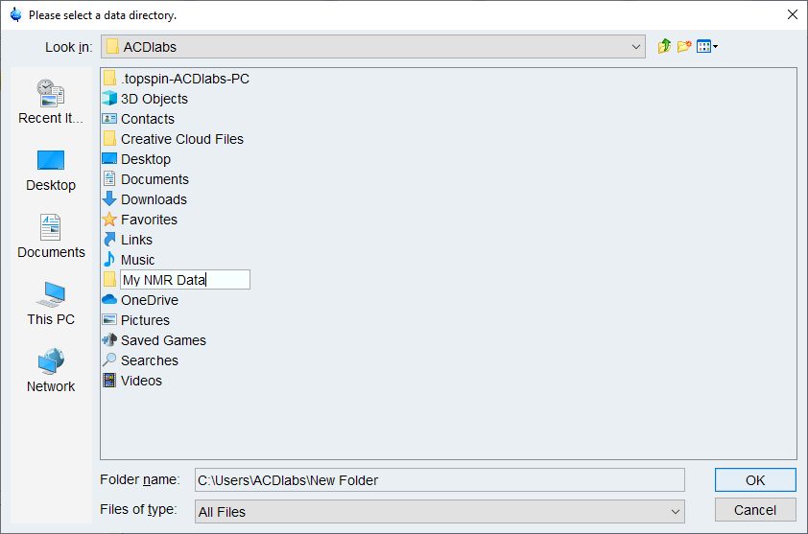
If you right-click on the Browser window in Topspin you will get the
Option to permanently add the folder for your NMR spectra.

Slide 35
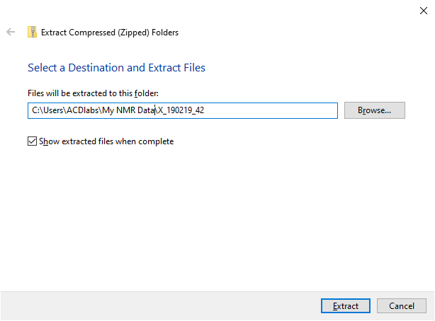
When you download zipped data from the NMR website you can then
Extract it (right click on the downloaded file in Explorer) into your NMR folder.

